Slide 1
Physical Activity, Health and Wellbeing – Session 5 1 – Physical Inactivity & Obesity 2 – Physical Activity & Public Health Policy

Slide 2
Intended learning outcomes
Understand the prevalence and health implications of obesity
Explore the relationship between PIA/PA and obesity
Review key public health policies which influence PIA/PA and obesity

Slide 3
Part 1 - Physical Inactivity and Obesity
Prevalence of obesity
Health implications of obesity
Prevalence of PIA
Relationship between PIA and obesity

Slide 4
Definition of Obesity
Abnormal or excessive fat accumulation that may impair health (WHO, 2021)
Generally defined by anthropometric measures
e.g. body mass index (BMI)

Slide 5
Measuring Obesity
BMI
Easily measured – just needs an individual’s weight (in kg) and height (in metres)
On a calculator – weight divided by height divided by height again
Apps & online tools
Waist circumference
Waist to hip ratio
Waist to height ratio
Body fat percentage
Skinfold measures
Bio Impedance Analysis (BIA)

Slide 6
Categories of obesity using BMI
Body mass index is an indicator of weight in relation to a person’s height
Weight (in kilograms) divided by the square of your height (in meters)
BMI units are kg/m²
Adult BMI classifications
Underweight <18.5
Healthy weight 18.5 – 24.9
Overweight 25.0 – 29.9
Obesity I 30.0 – 34.9
Obesity II 35.0 – 39.9
Obesity III (morbid or severe obesity) 40+

Slide 7
Growth charts in children
Note – childhood overweight and obesity is calculated differently to adults due to the rate of development varying during growth stages
Growth charts are used to compare to expected standards of height and weight taking age into account

Slide 8
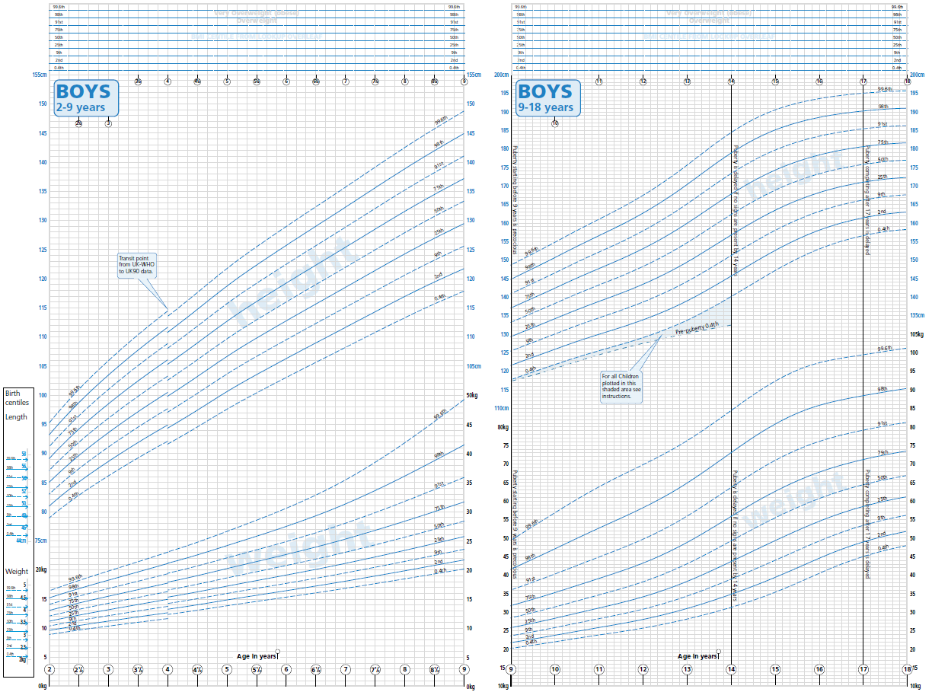
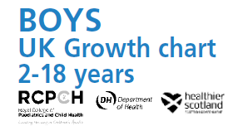

Slide 9
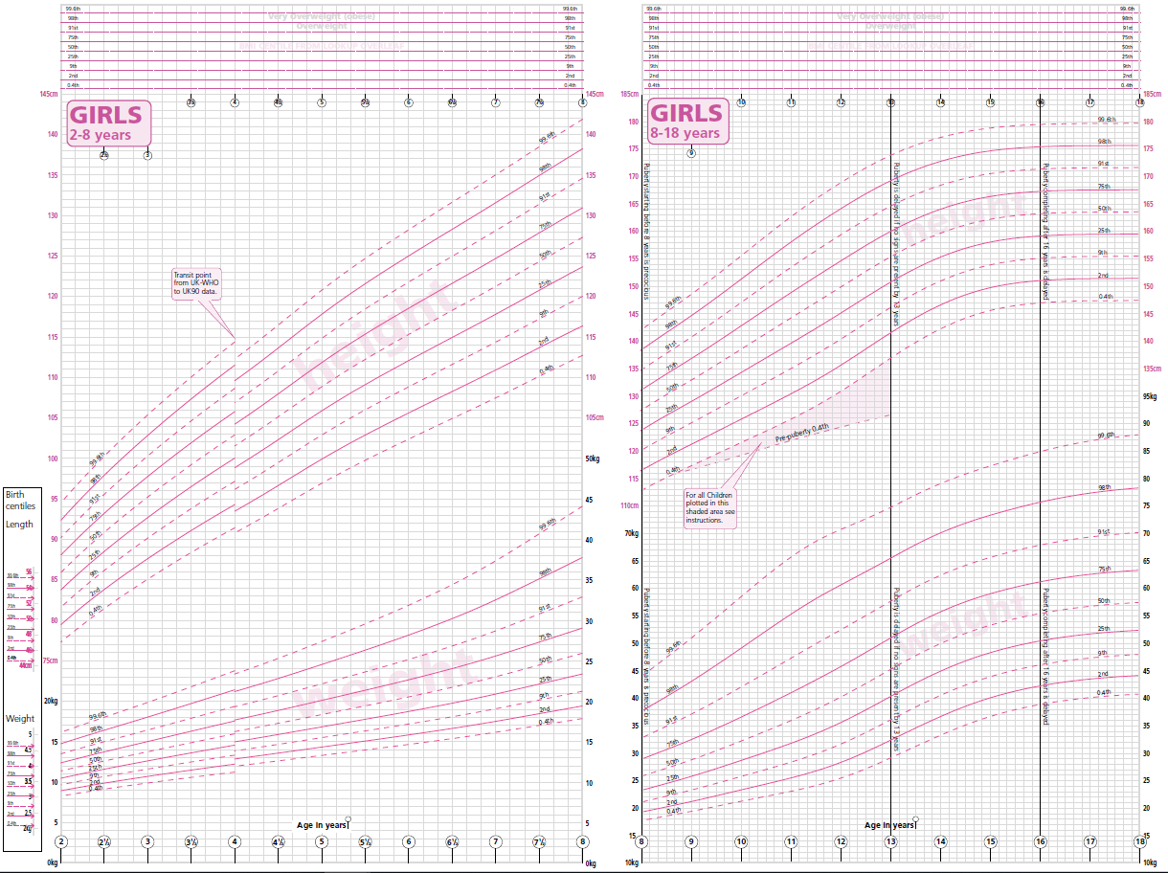
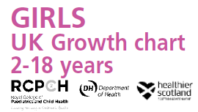

Slide 10
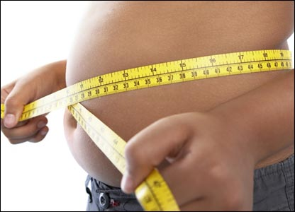
Central/Abdominal Obesity
Possible to have ‘healthy’ BMI and central obesity
‘Apple’ shape
Visceral fat surrounds internal organs
Increases risk of cardiovascular disease, type-2 diabetes, dyslipidaemia* (independent of BMI)
* Dyslipidaemia – obesity associated with high levels of LDL (bad) cholesterol and triglycerides and low levels of HDL (good) cholesterol
Generally defined in relation to waist circumference
can also be measured using CT, MRI scans, waist: hip ratio
Individual variations possible within same circumference
BME variations of risk (NICE PH46, 2013)

Slide 11
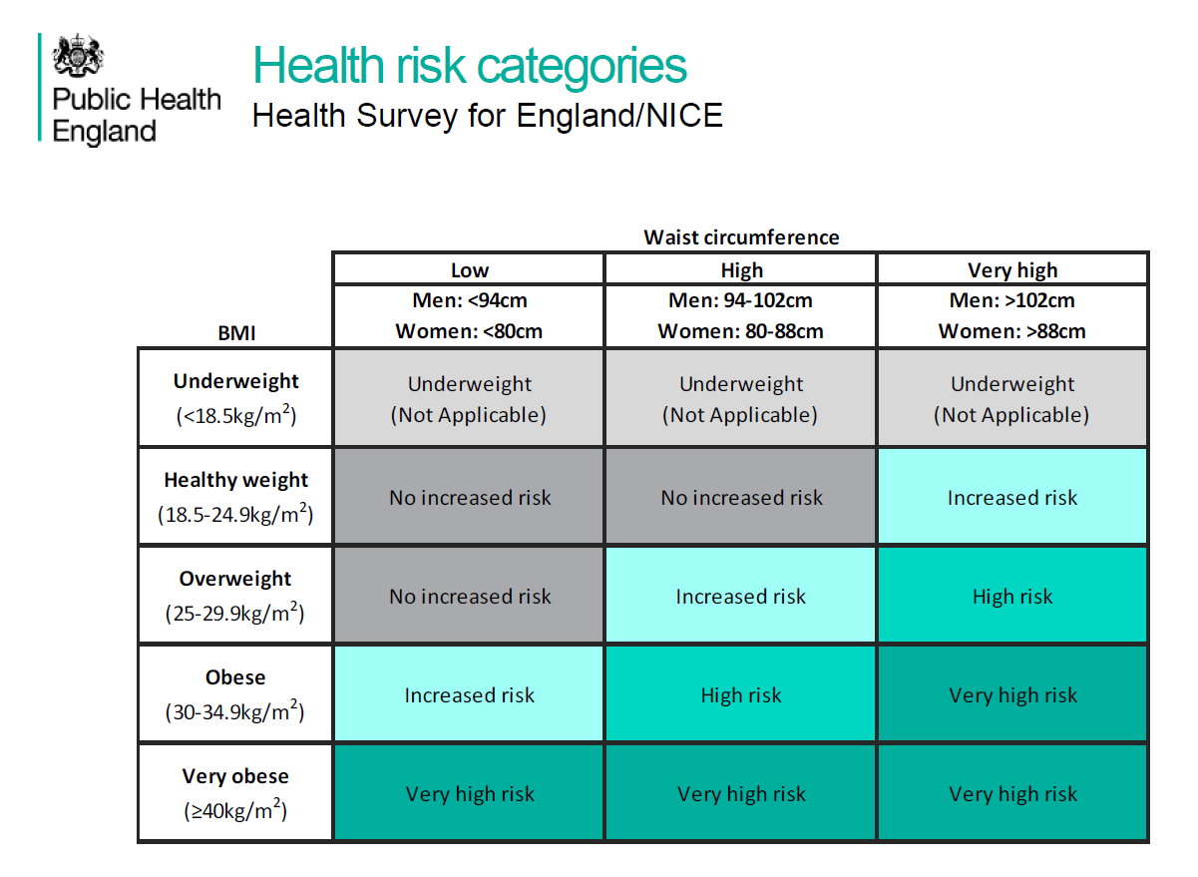

Slide 12
Global Issue of Obesity – ‘Globesity’
Worldwide obesity has nearly tripled from 1975-2016
1.9 billion adults were overweight
650 million adults were obese
41 million children under 5 were overweight or obese
340 million 5-19 year olds were overweight or obese
WHO (2021)

Slide 13
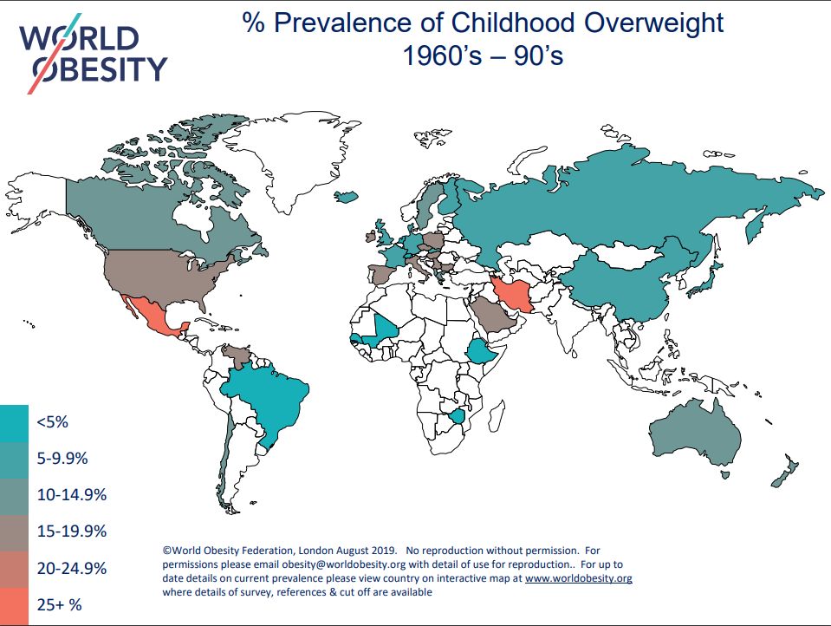

Slide 14
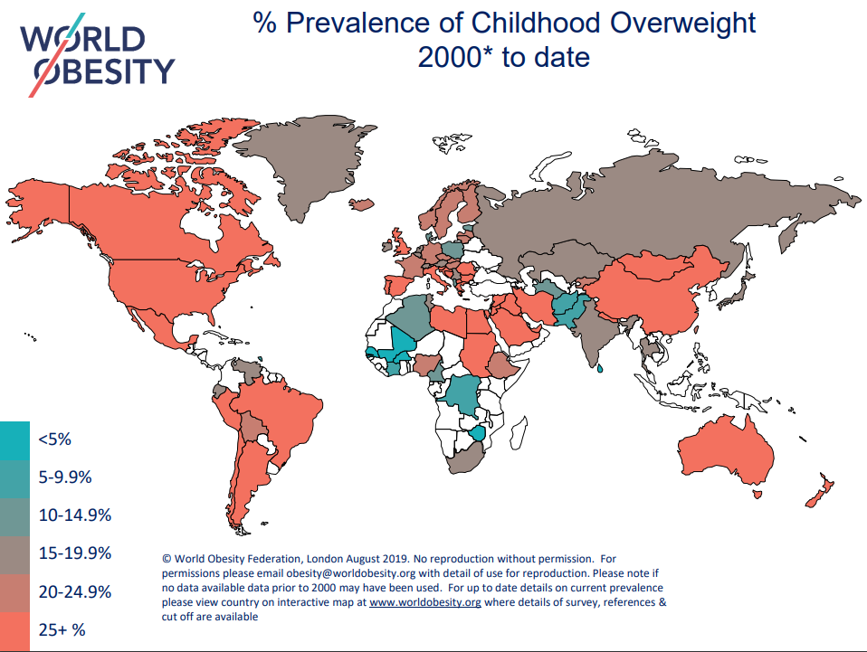

Slide 15
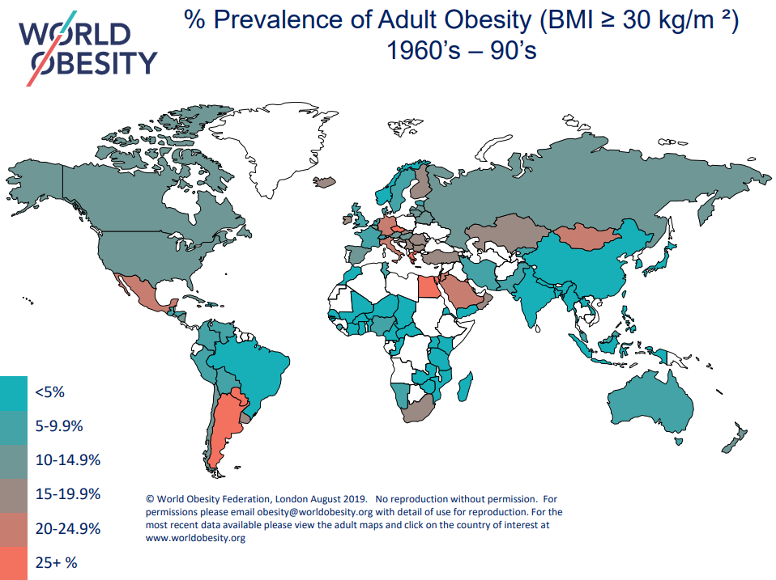

Slide 16
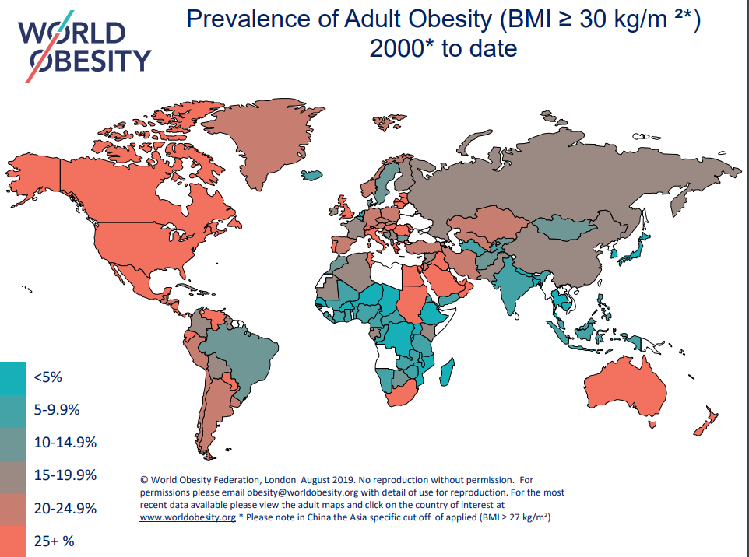

Slide 17
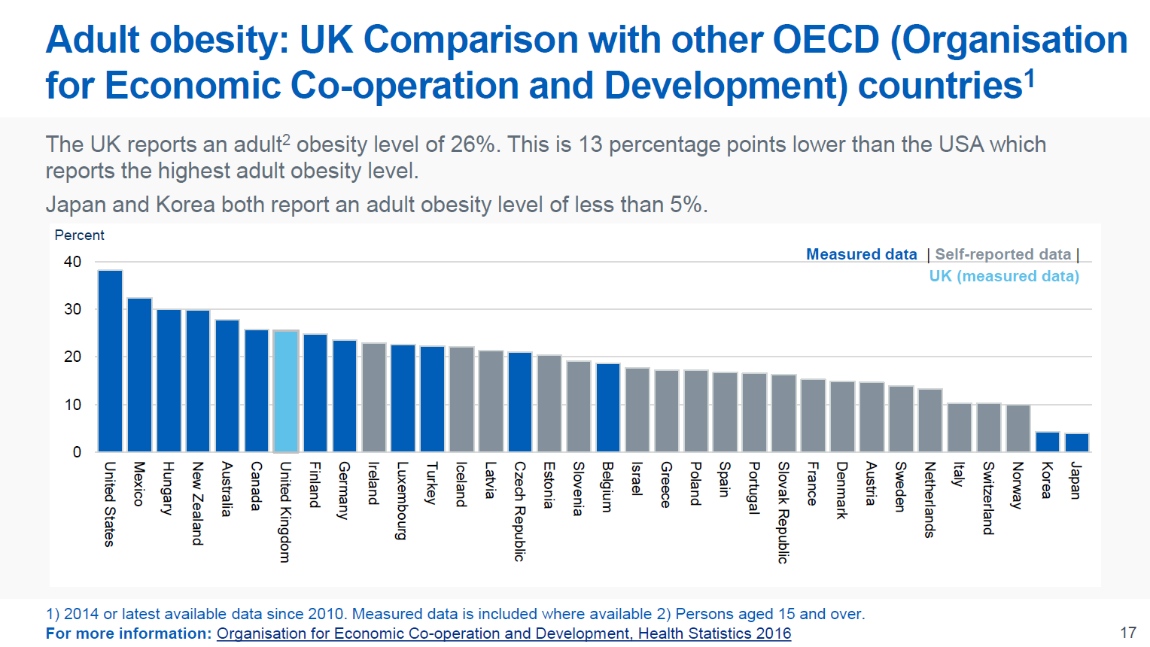
International Picture

Slide 18
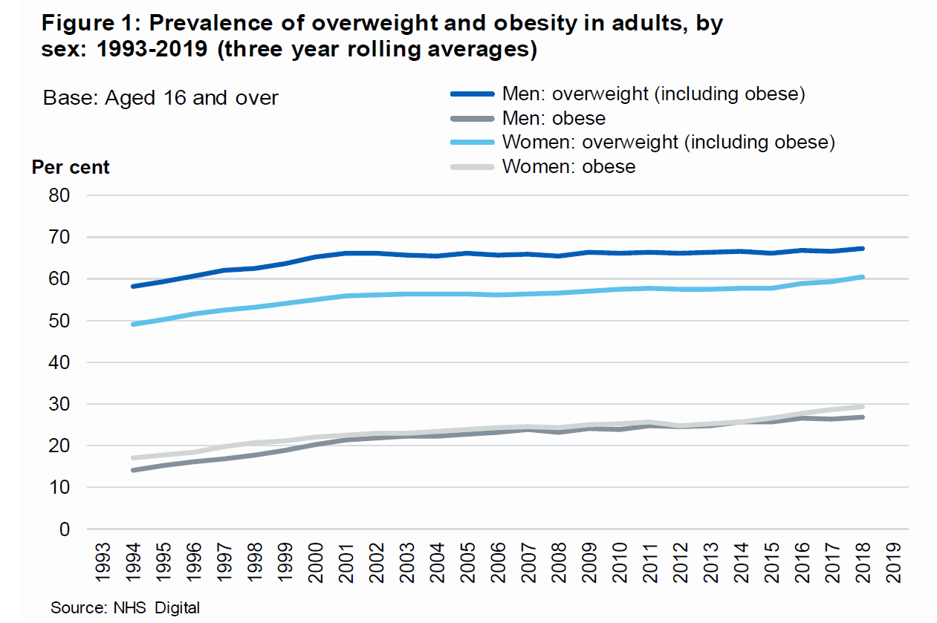
Health Survey for England (2020)

Slide 19
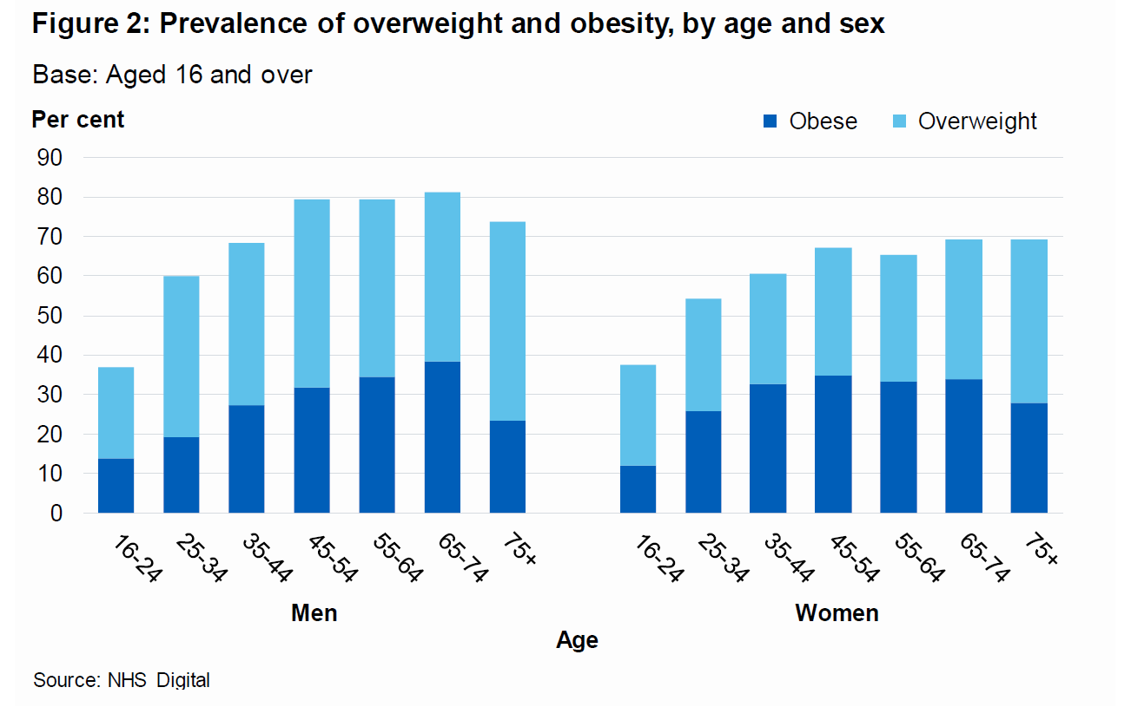
Health Survey for England (2020)

Slide 20
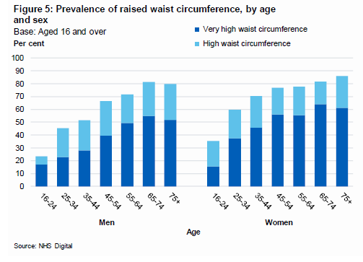
Health Survey for England (2020)

Slide 21
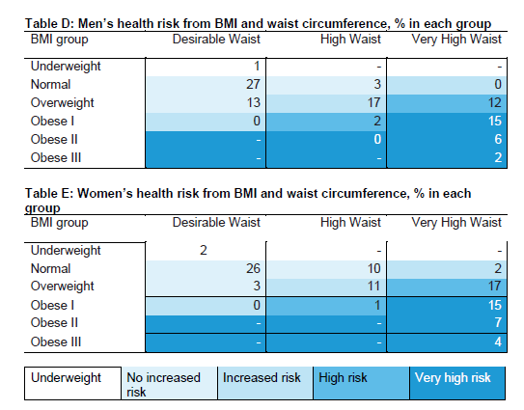
Health Survey for England (2020)

Slide 22
Trend in prevalence of severe obesity among adults Health Survey for England 1993 to 2019 (three-year average)
Health Survey for England (2020)
Adult (aged 16+) severe obesity: BMI ≥ 40kg/m²
Notes:
The prevalence of severe obesity (BMI ≥40kg/m²) has increased since 1993 for both men and women. Overall, a very small proportion of the population are severely obese but the rise in prevalence has been substantial since 1993-1995; a 7 fold increase for men (increasing from 0.3% to 2.2% in 2017-2019) and a 3 fold increase for women (increasing from 1.5% to 4.5% in 2017-2019). Severe obesity prevalence is much higher for women than men.
Three-year averages have been used to smooth out any unusually high or low prevalence values from individual years, so the overall trend over time can be better understood.
Data before 2003 are unweighted; whereas from 2003, the data has been weighted for non-response.
The published Health Survey for England data used to produce these charts is available from: https://digital.nhs.uk/data-and-information/publications/statistical/health-survey-for-england/2019

Slide 23
Projected Trends
Keaver, et al. (2018)
Morbid obesity modelling projection
By 2035, 8% of English adult population expected to be morbidly obese
Wales 5%, Scotland 11%
Equates to 5,000,000 morbidly obese UK adults
Likely to have serious health and financial implications for society and UK health system

Slide 24
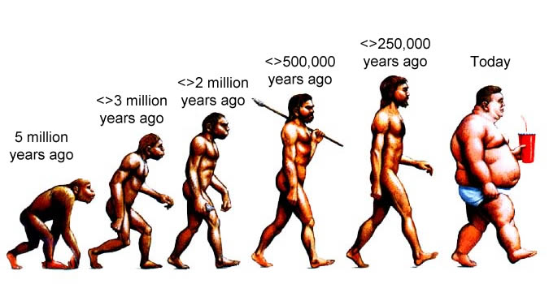
Evolution of Man

Slide 25
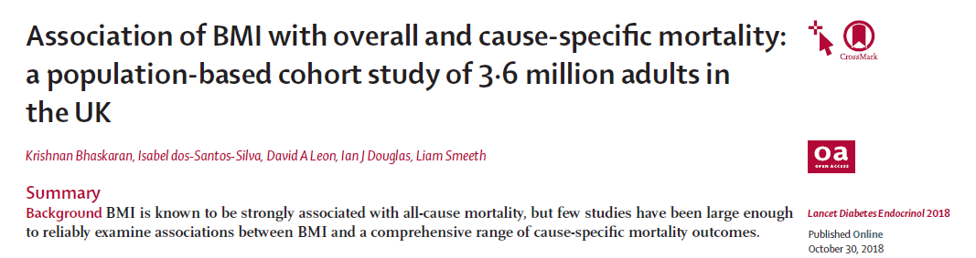
Relationship Between BMI & Mortality (Bhaskaran et al., 2018)
Significantly increased risk with higher BMI
Lowest risk at BMI of 23-24 kg/m²

Slide 26
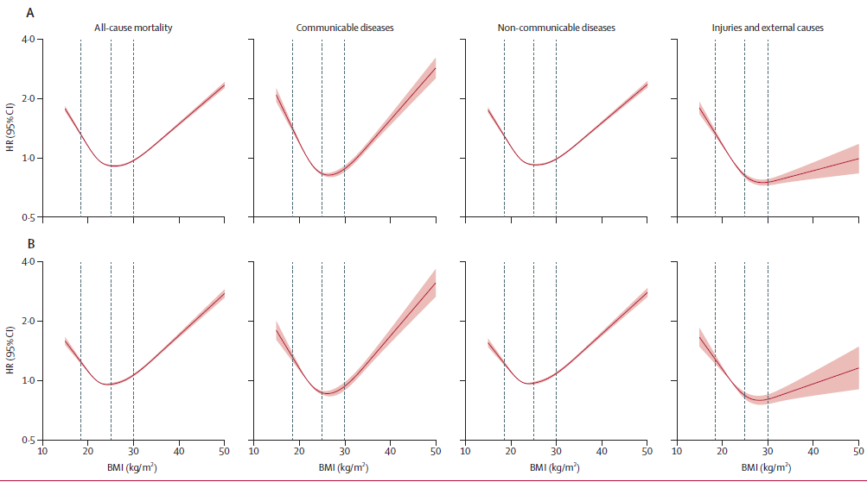
Mortality and BMI (Bhaskaran et al., 2018) A – all population B – never smokers

Slide 27
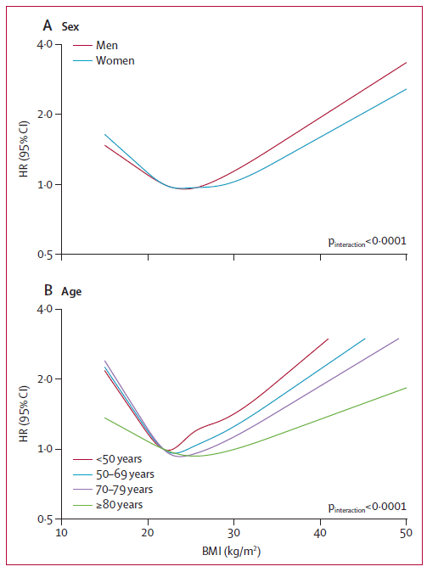
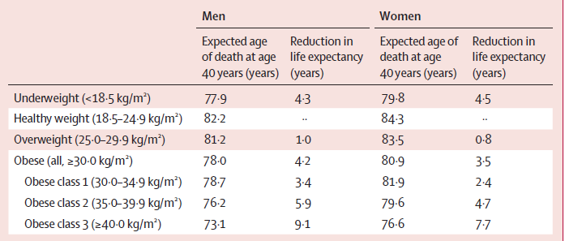
Mortality and BMI
Compared to healthy weight people at age 40:
Obese women live an average 3.5 years less
Morbidly obese women live 6.9 years less
Obese men live an average of 4.2 less
Morbidly obese men live 8.1 years less
(Bhaskaran et al., 2018)

Slide 28
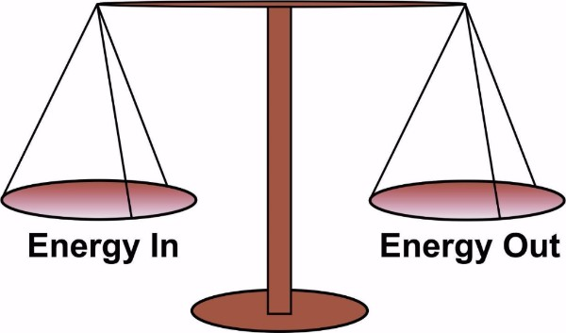
What causes obesity?
Is it just about energy balance?
i.e. eating too much, moving too little
Genetics
Medical reasons
Social influences
Obesogenic environment

Slide 29
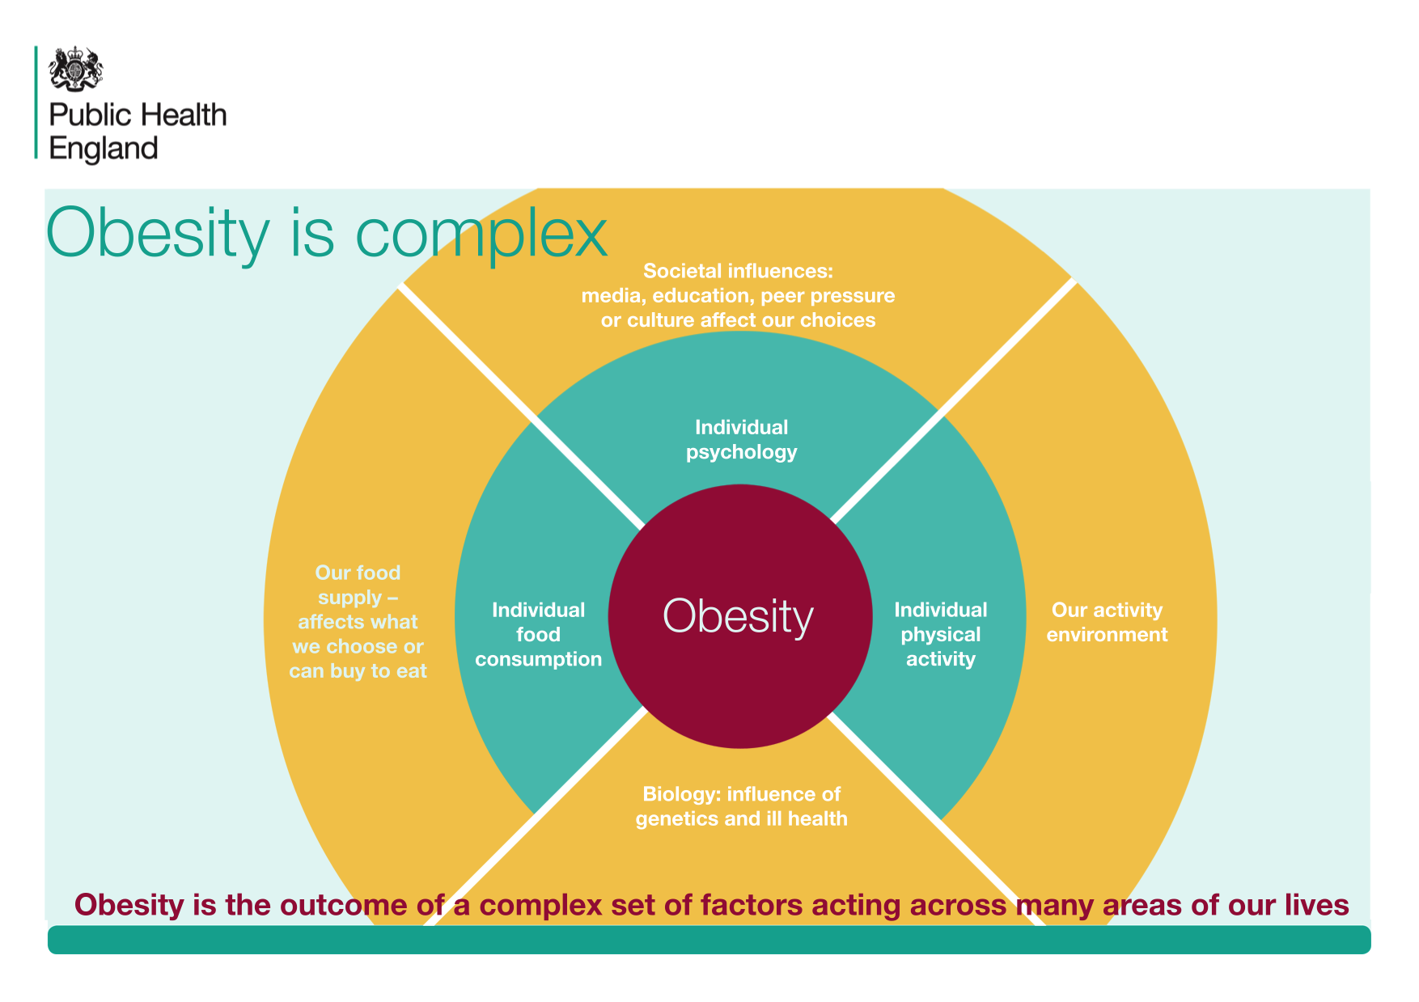

Slide 30
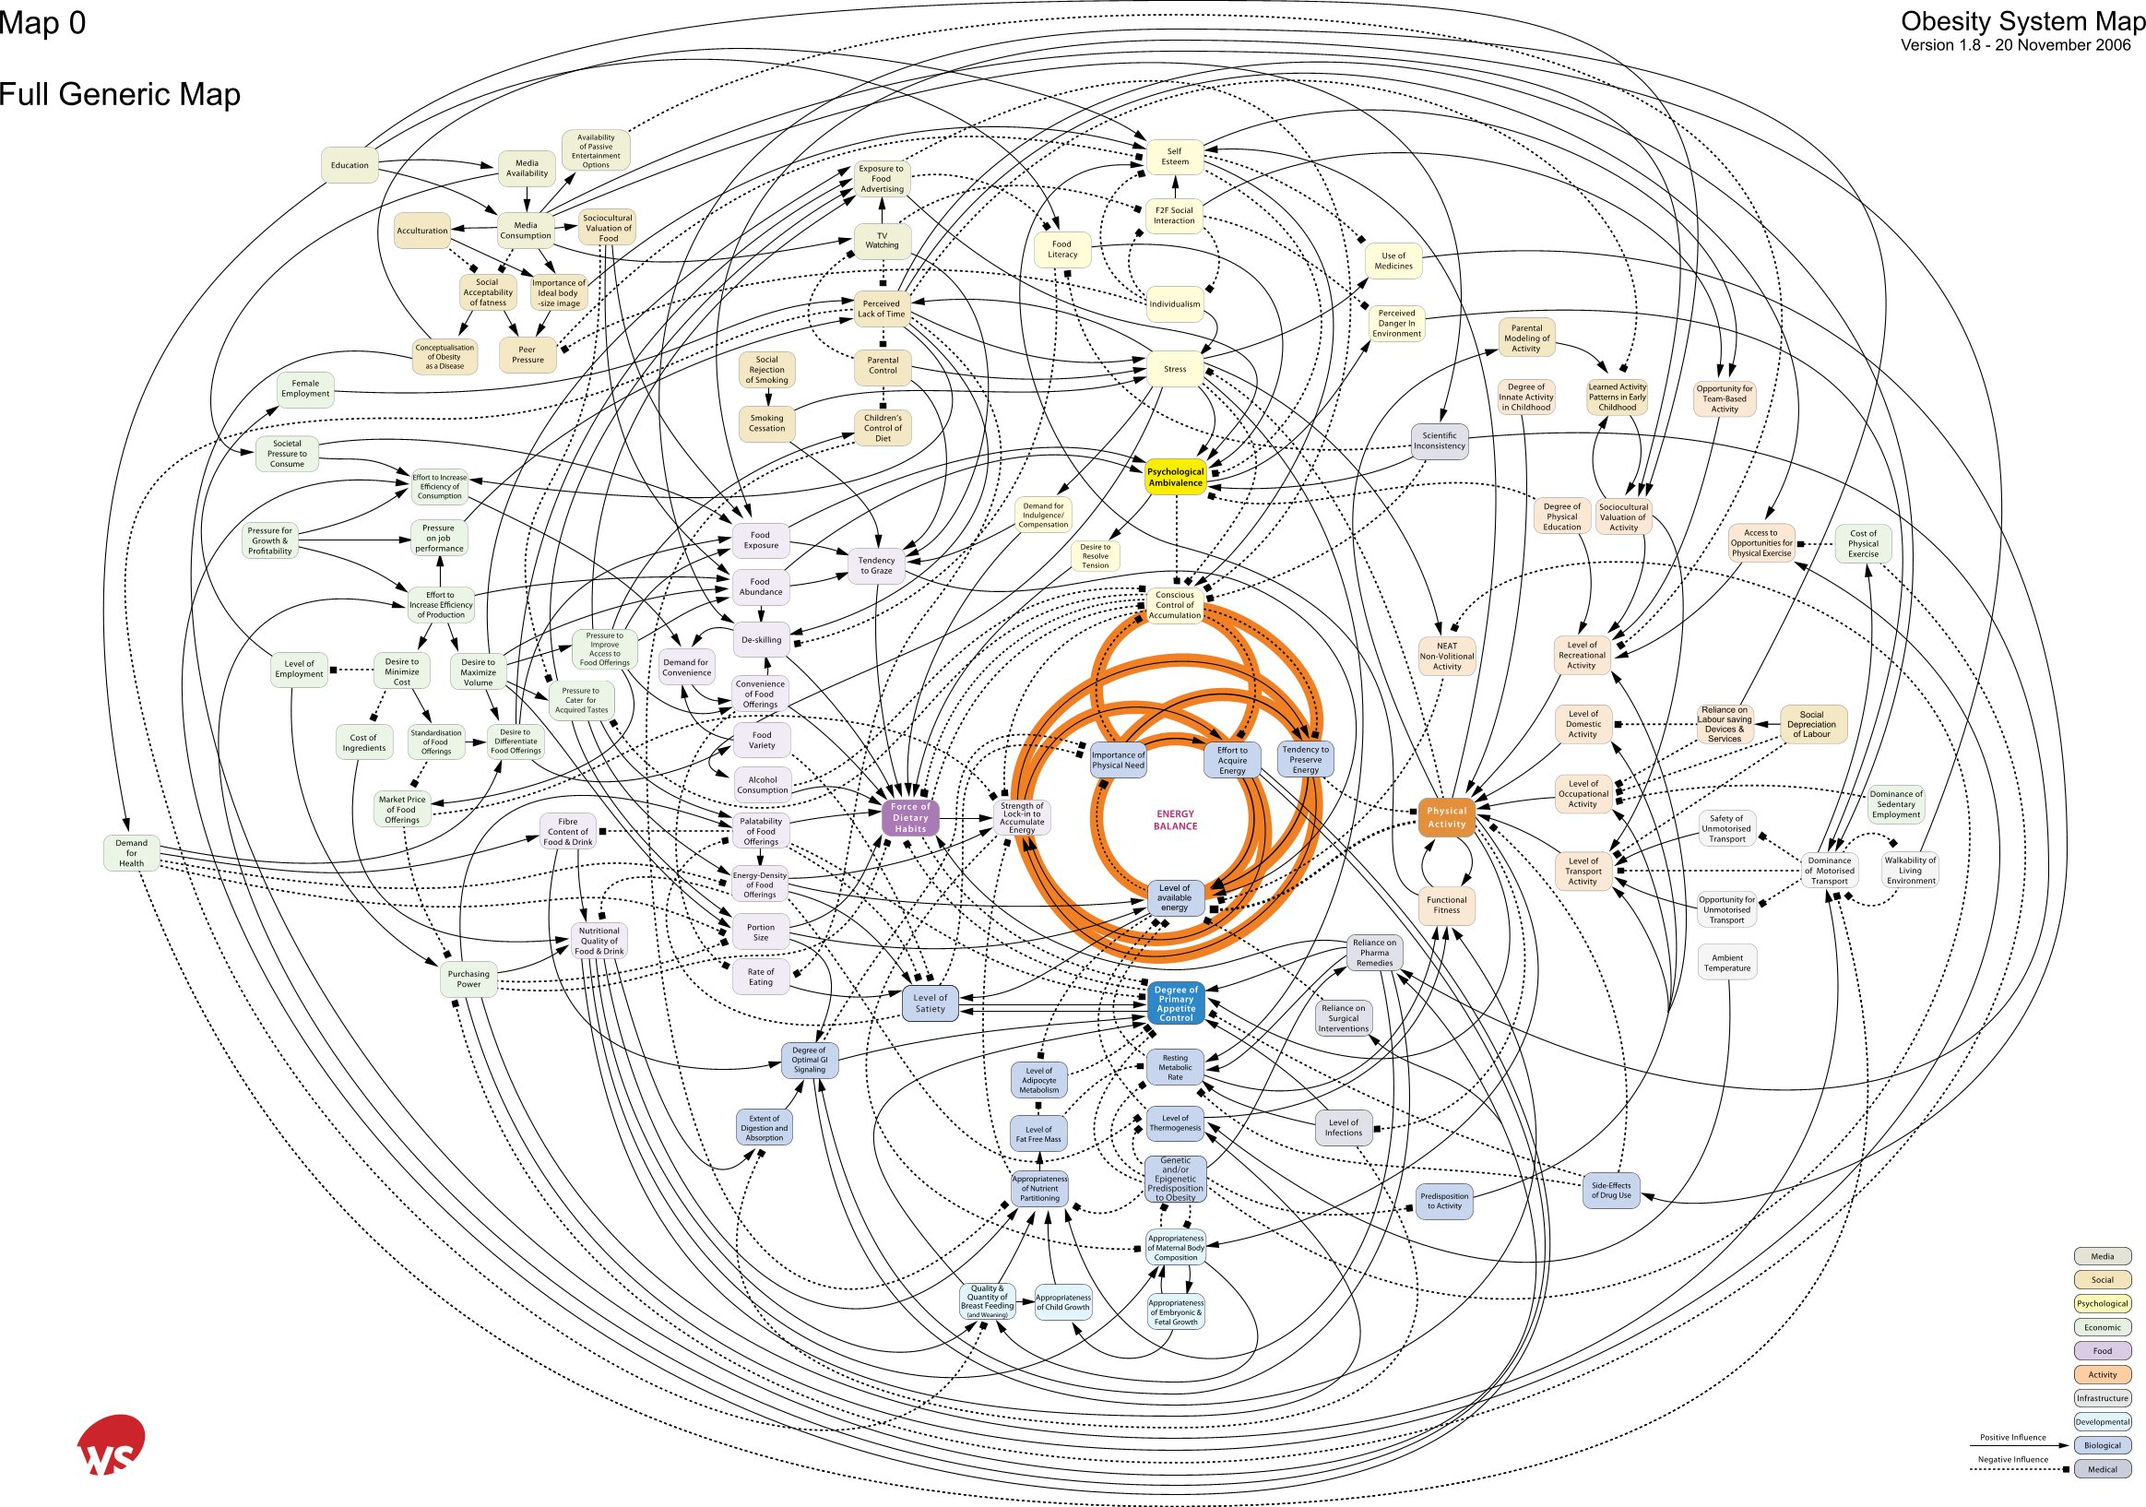
Societal influences
Individual psychology
Individual activity
Food
Consumption
Activity environment
Food Production
Biology
Notes:
Psychology clearly has an important place not just in the way it directly affects energy balance but also through its influences on
food consumption and activity a
the way we see ourselves in society
Interact with food supply through shopping
Way we perceive the activity environment in terms of risk and reward
The key factor however that solutions are likely to require multidisciplinary solutions. Hence the major emphasis by funders these day to create partnerships and teams of academics – something I will talk about later.

Slide 31
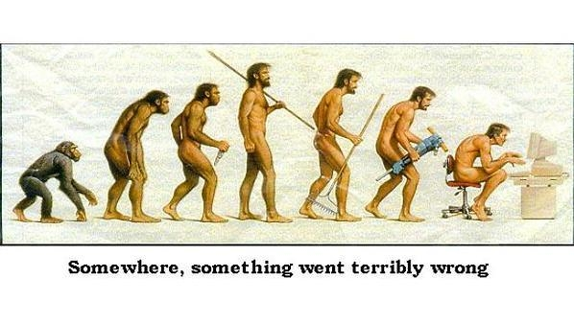

Slide 32
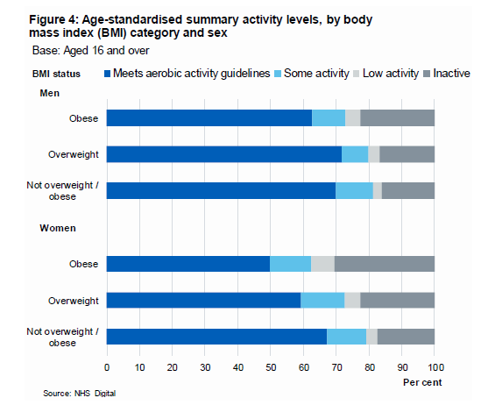
Health Survey for England, 2016 data

Slide 33
Health Implications of Obesity
Major risk factor for
cardiovascular disease
type II diabetes
metabolic syndrome
musculoskeletal disorders
some cancers
Etc., etc.
↑ Risk and severity with ↑ BMI
National Obesity Forum (2018)

Slide 34
Health Implications of PIA
“Strong evidence shows that physical inactivity increases the risk of many adverse health conditions, including major non-communicable diseases such as coronary heart disease, type 2 diabetes, and breast and colon cancers, and shortens life expectancy.”
Lee et al (2012)
Remember previous lectures
Also link to future lectures
Landmark studies
Framingham, London bus drivers, US railroad workers, Harvard Alumni, etc.
Refer to recent journal articles in essay

Slide 35
Health Implications of Obesity and PIA
Obesity
PIA
Major risk factor for:
cardiovascular disease
type II diabetes
metabolic syndrome
musculoskeletal disorders
some cancers
Etc., etc.
↑ Risk and severity with ↑ BMI
Major contributing factor to:
cardiovascular disease
type II diabetes
obesity
musculoskeletal disorders
some cancers
Etc., etc.
↑ Risk and severity with ↑ PIA

Slide 36
PA Volume and Obesity
BASES – ABC of PA for Health (2010)
Adults struggling to maintain normal weight need to:
Reduce energy intake
Minimise sedentary time
Go beyond levels of PA
Aim for 300 minutes per week of moderate intensity PA (MIPA)
Or 150 minutes per week of vigorous intensity PA (VIPA)
ACSM – Appropriate PA Interventions for Weight Loss (2009)
200-300 minutes per week of MIPA recommended for weight loss
Weight maintenance after weight loss is improved by >250 minutes per week of MIPA

Slide 37
PA Volume and Obesity
Saris et al. (2003) – Consensus statement of IASO
45-60 minutes of MIPA per day needed to prevent transition to obesity
Formerly obese individuals may need 60-90 minutes MIPA per day
Freidenreich et al. (2019) – PA dose effects on body fat
300 vs 150 minutes MIPA per week during intervention
Body fatness changes followed up 12 months post intervention
High volume PA group had better BMI, waist to hip ratio, abdominal fat
No difference in total body fat loss

Slide 38
PA Intensity and Obesity
Growing trend for high intensity interval training (HIIT)
Evidence of improvement in certain clinical markers
Way et al. (2018) - HIIT vs continuous MIPA and BP
Improved blood pressure responses in HIIT group
No difference in arterial stiffness
Whyte et al. (2013) – HIIT and sedentary overweight/obese men
A single bout of HIIT increased insulin sensitivity and fat oxidation

Slide 39
PA Intensity and Obesity
Viana et al (2019) - HIIT vs continuous MIPA
The magic bullet?
HIIT provided 28.5% greater reductions in fat mass than continuous MIPA
Su et al. (2019) - HIIT vs continuous MIPA and CVD risk
Similar benefits for body composition, vO2 max, total cholesterol
Better cardiopulmonary fitness improvement in HIIT
High intensity is hard - near maximal effort required
Remember last week’s intensity activity?!

Slide 40
PA Intensity and Obesity
Larsen et al (2013) studied cellular changes during HIIT
Untrained subjects showed signs of oxidative stress and cell damage
Recommendation for pre-training prior to HITT
De Feo (2013) questioned whether HIIT or MIPA is better for weight loss
Pro – superior aerobic fitness improvement
Con – decreased adherence
Adherence critical for any PA related adaptation (as discussed last week)
Adaptations are reversible

Slide 41
Is obesity a disease or lifestyle disorder?
On-going debate
Fat but fit?
Thin but metabolically obese?
Sarcopenic obesity?
PA benefits are independent of weight loss
Classified as a disease in some countries
E.g. USA & Canada – not in the UK (yet)
Need to reclassify definition?

Slide 42
Part 2 - Physical Activity, Obesity & Public Health Policy
Remember essay title….
With reference to the evidence base and epidemiological data, critically explore why physical inactivity should be a public health priority

Slide 43
Government Role in Tackling Obesity
Healthy Lives, Healthy People: A call to action on obesity in England
Helping people make healthy food choices
Helping people be more active
Transforming the workplace and wider environment
Speaking directly to individuals and families through Change4Life
Devote approx. £14m to Change4Life
Dept. of Health (2011)

Slide 44

APPG Summary of Recommendations (2018)
A national obesity strategy
Obesity/weight management training at medical school
9pm watershed for advertising of food and drink high in fat, sugar and salt
Investigate whether obesity should be classified as a disease
Government should commission or support the development of a cost benefit analysis of obesity interventions

Slide 45
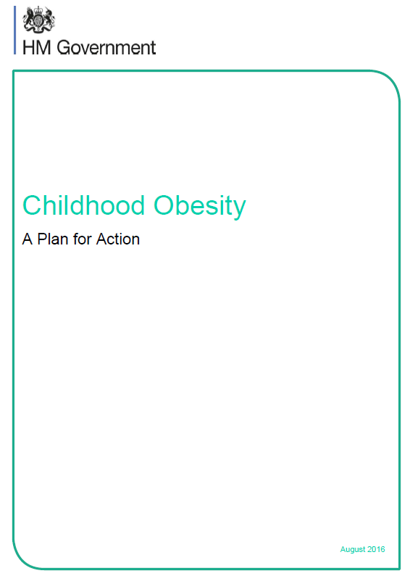
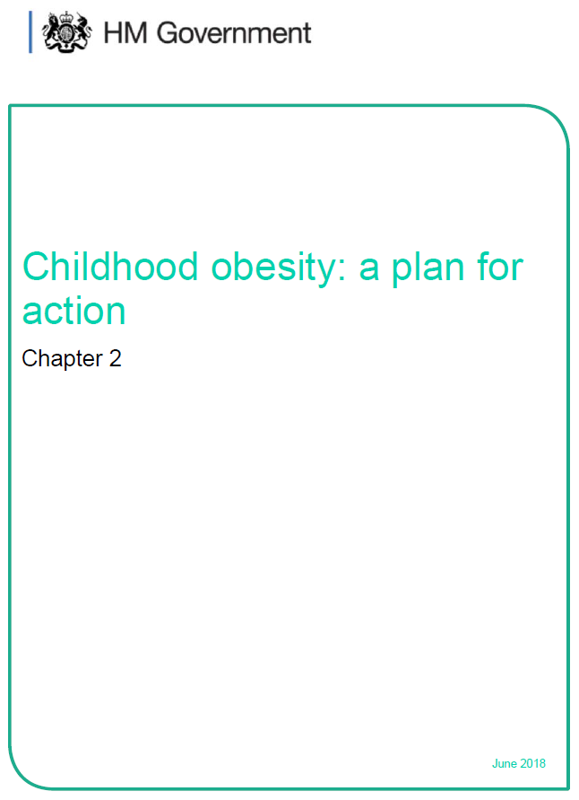
Childhood Obesity Plan (2016, 2018)

Slide 46
Childhood Obesity Plan - Key Points
Soft drink industry levy (came into force 6th April 2018)
Asks the food and drink industry to cut the sugar in products popular with children
5% cut in year one (not achieved!)
20% cut by 2020
Make healthy options available in the public sector
Clearer food labelling
Helping children enjoy an hour of PA a day
Enabling health professionals to support families

Slide 47
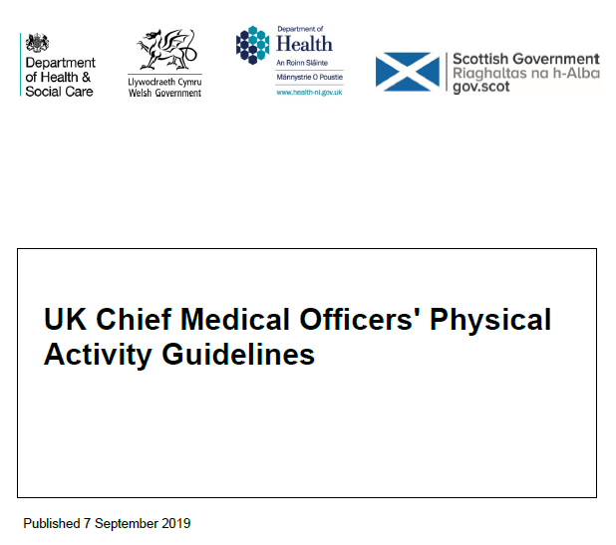
Current UK PA Guidelines
UK consensus on the amount and type of PA needed to benefit health
Summarises guidelines by age groups:
Under 5’s
Infants, toddlers and pre-schoolers
Children and young people
Adults
Older adults
Additional guidelines for
pregnant women
women after childbirth (birth – 12 months)
disabled adults

Slide 48
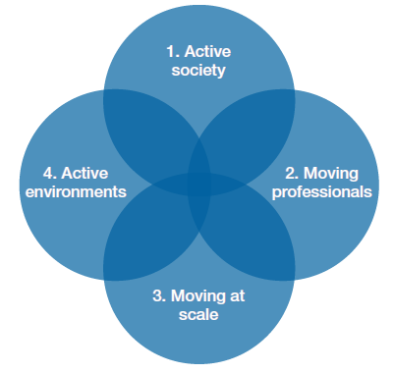
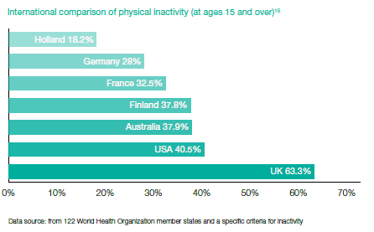
Everybody Active, Every Day (PHE, 2014) An evidence-based approach to physical activity
Action required across the four areas. PHE outlines how they intend to support local and national action

Slide 49
Everybody Active, Every Day (PHE, 2014)
Supported by PHE’s Health matters: getting every adult active every day (2016)
Resources section online
Role identified for healthcare professionals, NHS commissioners, sports and leisure sector
Available at: https://www.gov.uk/government/publications/health-matters-getting-every-adult-active-every-day/health-matters-getting-every-adult-active-every-day#contents

Slide 50
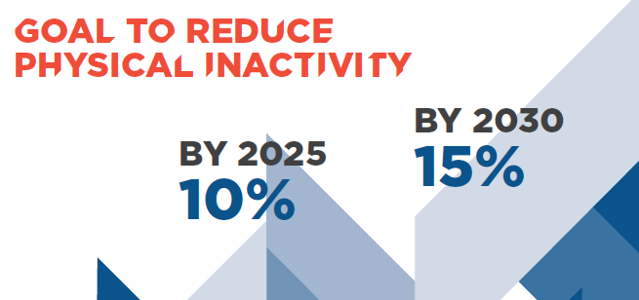
Global PIA Issue
WHO (2018) – Global Action Plan on PA 2018-2030: More active people for a healthier world
Create active societies
Create active environments
Create active people
Create active systems

Slide 51


Slide 52
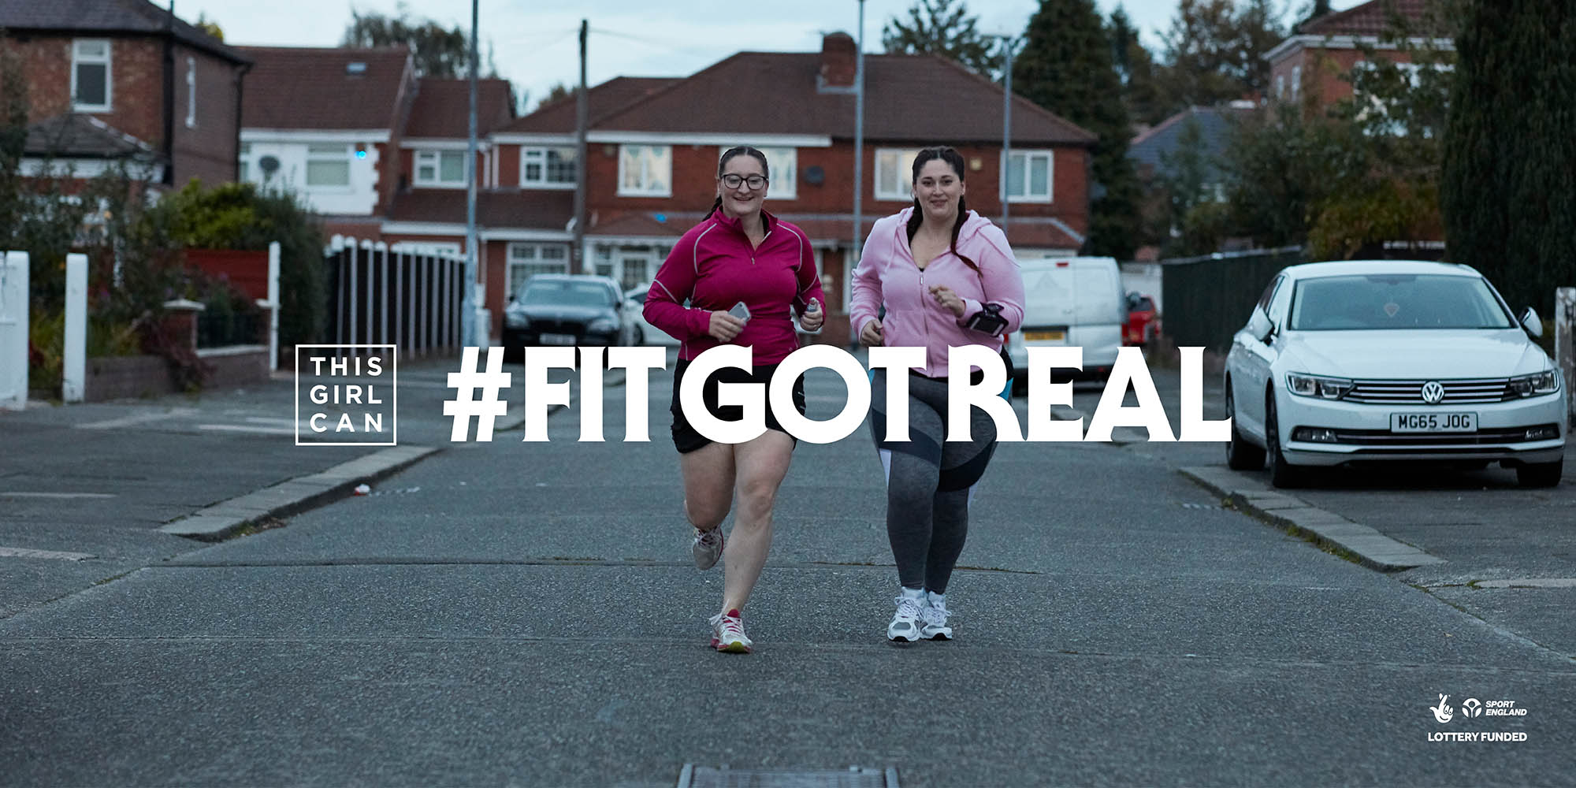

Slide 53
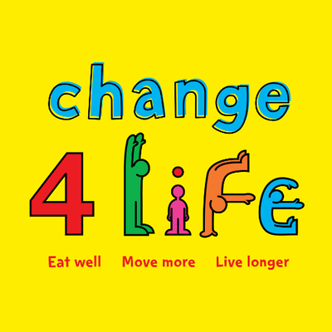
Many apps and programmes available locally
https://www.nhs.uk/healthier-families/

Slide 54
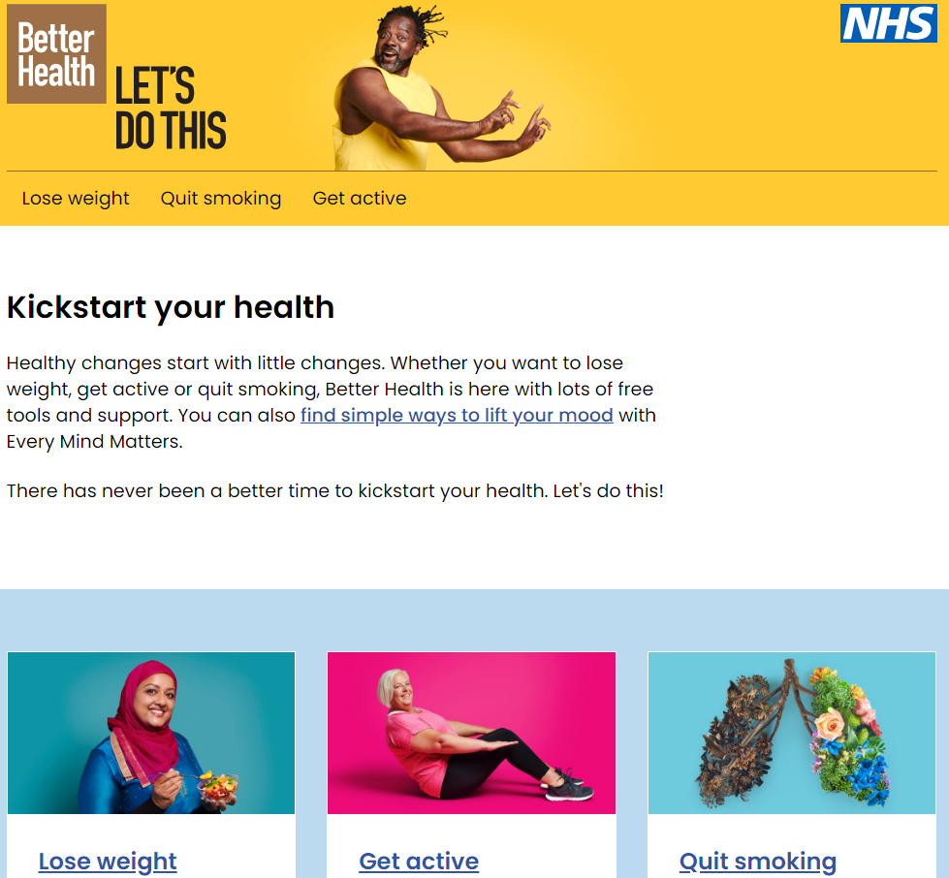

Slide 55
Review of learning outcomes
Understand the prevalence and health implications of obesity
Explore the relationship between PIA/PA and obesity
Review key public health policies which influence PIA/PA and obesity

Slide 56
References
All Party Parliamentary Group on Obesity (2018). The current landscape of obesity services: a report from the All-Party Parliamentary Group on Obesity. Available at: http://www.bomss.org.uk/wp-content/uploads/2018/05/APPG-Obesity-2018.pdf
American College of Sports Medicine (2009). Appropriate Physical Activity Interventions for Weight Loss and Prevention of Weight Regain for Adults. Medicine and Science in Sports and Exercise. 41. 460-471.
British Association of Sport and Exercise Sciences (2010). The ABC of Physical Activity for Health: A consensus statement from the BASES. Journal of Sports Sciences, 28:6, 573-59.
Bhaskaran, K., dos Santos Silva, I., Leon, D., Douglas, I., and Smeeth, L. (2018) Association of BMI with overall and cause-specific mortality: a population-based cohort study of 3.6 million adults in the UK. Lancet Diabetes and Endocrinology. 6:12, 943-953.
De Feo (2013). Is high-intensity exercise better than moderate-intensity exercise for weight loss? Nutrition, Metabolism and Cardiovascular Diseases. 23, 1037-1042.
Department of Health (2011) Healthy Lives, Healthy People: A Call to Action on Obesity in England. Available at: https://assets.publishing.service.gov.uk/government/uploads/system/uploads/attachment_data/file/213720/dh_130487.pdf

Slide 57
References
Department of Health and Social Care (2019) UK Chief Medical Officers’ Physical Activity Guidelines. Available at: https://assets.publishing.service.gov.uk/government/uploads/system/uploads/attachment_data/file/832868/uk-chief-medical-officers-physical-activity-guidelines.pdf (Accessed: 19 February 2022).
Freidenreich, C., Ruan, Y., Duha, A. and Courneya, K. (2019). Exercise Dose Effects on Body Fat 12 Months after an Exercise Intervention: Follow-up from a Randomized Controlled Trial. Journal of Obesity. doi.org/10.1155/2019/3916416
HM Government (2016). Childhood Obesity: A Plan for Action. Available at: https://assets.publishing.service.gov.uk/government/uploads/system/uploads/attachment_data/file/546588/Childhood_obesity_2016__2__acc.pdf (Accessed: 19 August 2022).
Keaver, L., Xu, B., Jaccard, A. and Webber, L. (2018) Morbid obesity in the UK: A modelling projection study to 2035. Scandinavian Journal of Public Health. Available at: https://journals.sagepub.com/doi/pdf/10.1177/1403494818794814
Larsen, F, et al. (2016). High-intensity sprint training inhibits mitochondrial respiration through aconitase inactivation. The FASEB Journal. 30. 417-427
Lee, I., Shiroma, E.J., Lobelo, F., Puska, P., Blair, S.N., Katzmarzyk, P.T., for the Lancet Physical Activity Series Working Group (2012). Effect of physical inactivity on major non-communicable diseases worldwide: An analysis of burden of disease and life expectancy. The Lancet; 380(9838): 219-229.

Slide 58
References
NHS Digital (2020) Health Survey for England, overweight and obesity in adults and children. Available at: https://digital.nhs.uk/data-and-information/publications/statistical/health-survey-for-england/2019 (Accessed: 18 February 2022).
Public Health England (2016) Health matters: getting every adult active every day. Available at: https://www.gov.uk/government/publications/health-matters-getting-every-adult-active-every-day/health-matters-getting-every-adult-active-every-day
OECD Health Division (2017) Obesity Update 2017. Available at: http://www.oecd.org/health/health-systems/Obesity-Update-2,017.pdf (Accessed: 19 August 2022).
Saris, W., Blair, S., van Baak, M, Eaton, S., Davies, P., Di Pietro, L., Fogelhol, M., Rissanen, A., Schoeller, D., Swinburn, B., Tremblay, A., Westerterp, K., and Wyatt, H. (2003). How much physical activity is enough to prevent unhealthy weight gaon? Obesity Reviews. 4. 101-104
Su, L., Fu, J., Sun, S., Zhao, G., Cheng, W., Dou, C. and Quan, M. (2019). Effects of HIIT and MICT on cardiovascular risk factors in adults with overweight and/or obesity: A meta-analysis. Plos One. 14 (1) 1-21
Sung, H., Siegel, R., Rosenberg, P., Jemal, A. (2019). Emerging cancer trends among young adults in the USA: analysis of a population-based cancer registry. Lancet Public Health. http://dx.doi.org/10.1016/S2468-2667(18)30267-6

Slide 59
References
Vianna, R, Naves, J., Coswig, V., de Lira, C., Steele, J., Fisher, J. and Gentil, P. (2019). Is interval training the magic bullet for fat loss? A systematic review and meta-analysis comparing moderate-intensity continuous training with high-intensity interval training (HIIT). British Journal of Sports Medicine; 0: 1-12
Way, K., Sultana, R., Sabag, A., Baker, M., and Johnson, N. (2018). The effect of high-intensity interval training versus moderate intensity continuous training on arterial stiffness and 24h blood pressure responses: A systematic review and meta-analysis. Journal of Science and Medicine in Sport. https://doi.org/10.1016/j.jsams.2018.09.228
Wei, M., Kampert, J., Barlow, C., Nichaman, M., Gibbons, L., Paffenbarger, R., and Blair, S. (1999). Relationship Between Low Cardiorespiratory Fitness and Mortality in Normal-Weight, Overweight, and Obese Men. Journal of the American Medical Association. 282 (16), 1547-1553
Whyte, L., Ferguson, C., Wilson, J., Scott, R. and Gill, J. (2013). Effects of single bout of very high-intensity exercise on metabolic health biomarkers in overweight/obese sedentary men. Metabolism. 62; 212-219
World Health Organization (2021) Obesity and Overweight. Available at: http://www.who.int/news-room/fact-sheets/detail/obesity-and-overweight (Accessed: 19 August 2022).
World Health Organization (2018) Global Action Plan on Physical Activity 2018-2030.: More active people for a healthier world. Geneva: License: CC BY-NC-SA 3.0 IGO.

